Slide 1
Fundamentals of Blockchain
Dayanand Ambawade
Sardar Patel Institute of Technology,Mumbai

Slide 2
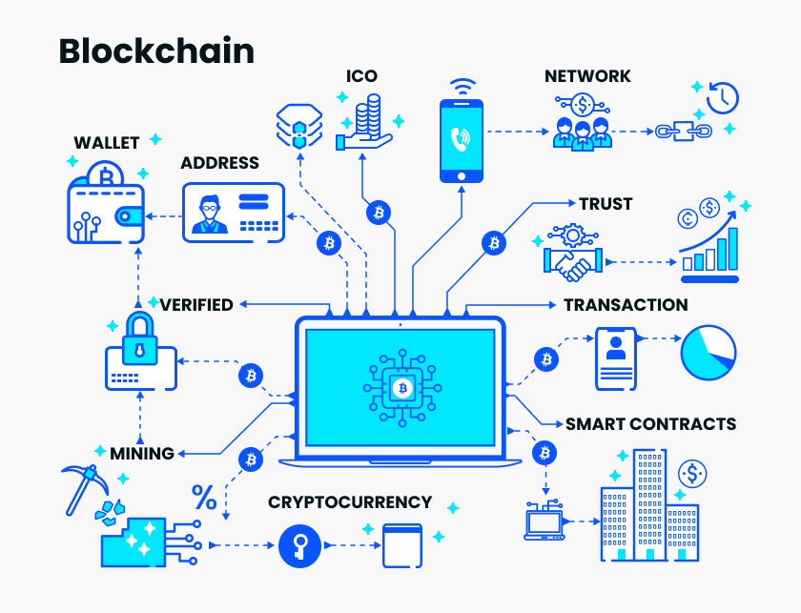
Introduction to Blockchain Technology

Slide 3
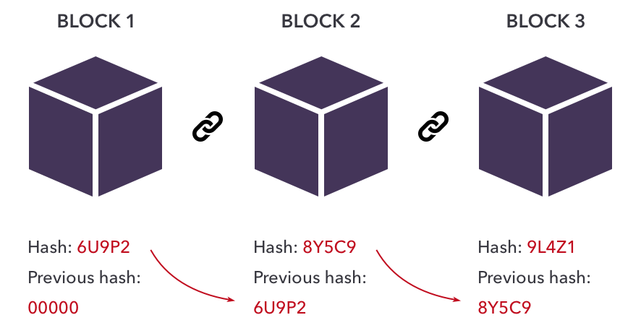
What is Blockchain Technology
Definition: Blockchain is a peer-to-peer, distributed ledger that is cryptographically secure, append-only, immutable (extremely hard to change), and updateable only via consensus or agreement among peers.
[1] In 2008, a groundbreaking paper, entitled Bitcoin: A Peer-to-Peer Electronic Cash System, was written on the topic of peer-to-peer e-cash under the pseudonym of Satoshi Nakamoto.

Slide 4
Definition of Blockchain
Layman's definition: Blockchain is an ever-growing, secure, shared
recordkeeping system in which each user of the data holds a copy of the
records, which can only be updated if all parties involved in a transaction
agree to update.

Slide 5
Defining Blockchain
Peer-to-peer (P2P)
Distributed Ledger
Cryptographically Secure
Append-Only
Updatable via consensus

Slide 6
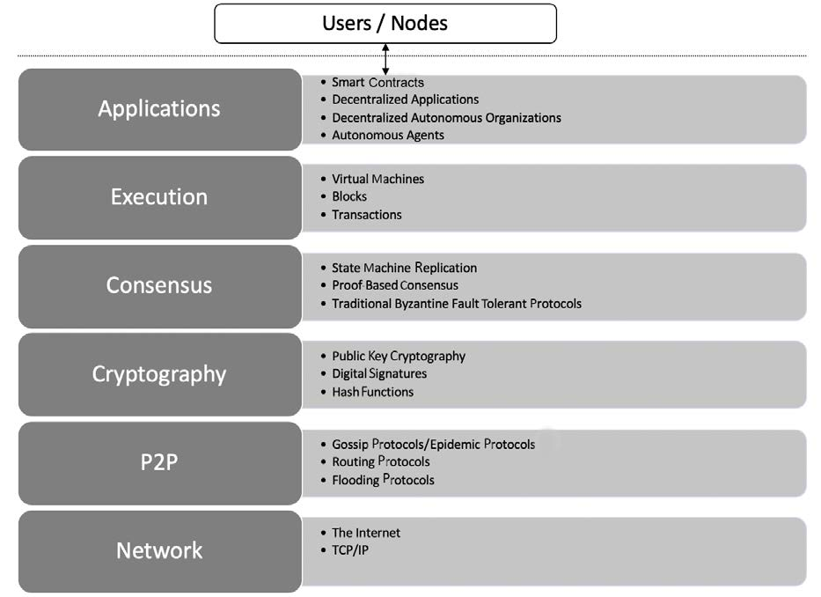
The architectural view of a generic blockchain

Slide 7
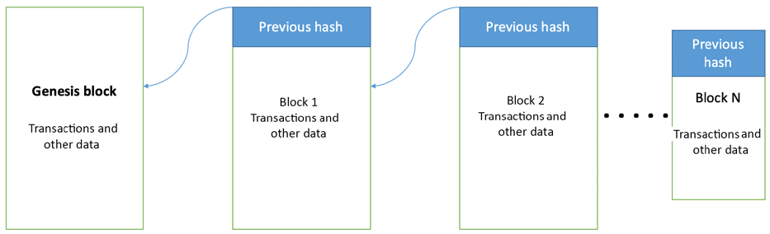
Generic elements of a blockchain

Slide 8
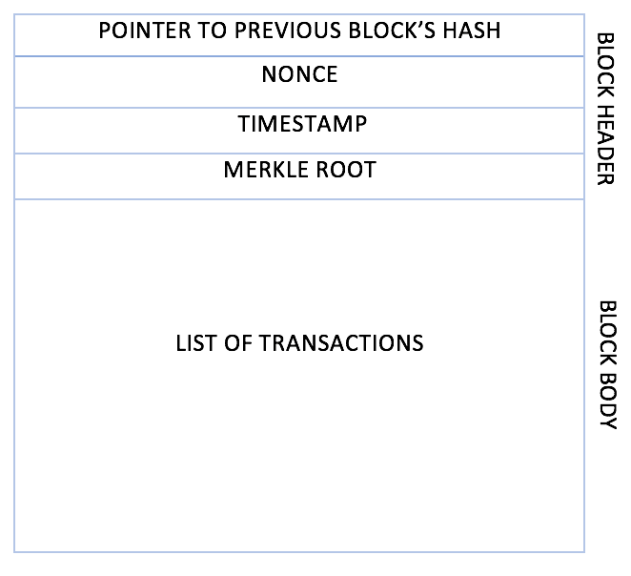
The generic structure of a block

Slide 9
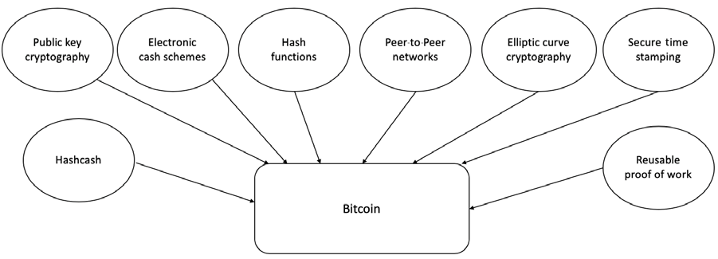
Cryptography and Bitcoin

Slide 10
Introduction to Bitcoin
Dayanand Ambawade

Slide 11
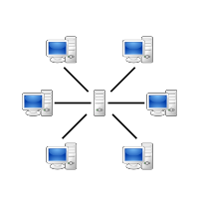


Simplified view of today’s Web
Client-server architecture
Centralized as in authority (The owner controls, and the user trusts)
Single point of failure.

Slide 12
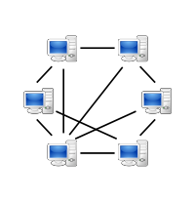


Decentralization
Decentralization as in authority
No one actually owns the network/service.
Decentralization as in architecture
Peer-to-Peer

Slide 13
Perks of decentralization
No single point of failure in the infrastructure.
Transparency.
No need to trust.
Elimination of middlemen

Slide 14
The concept of Decentralization
combined with
Cryptography techniques
lays foundation for a technology called
Blockchain
which is a data structure
(or shared distributed ledger)
to store information
(or transactions)
having highly desirable characteristics like
Persistence, Authenticity, Transparency, un-hackablity, and elimination of intermediaries.

Slide 15
Outline
What is Bitcoin
Bitcoin and Blockchain
Bitcoin’s Monetary Policy
Mining
Nonce
CPUs vs GPU vs ASICs
Mempool
UTXO
Transactions
Wallets
Public-key cryptography

Slide 16

Bitcoin was designed by Satoshi Nakamoto
“A Peer-to-Peer Electronic Cash System”
2008
The term block chain was coined by Satoshi in this paper

Slide 17
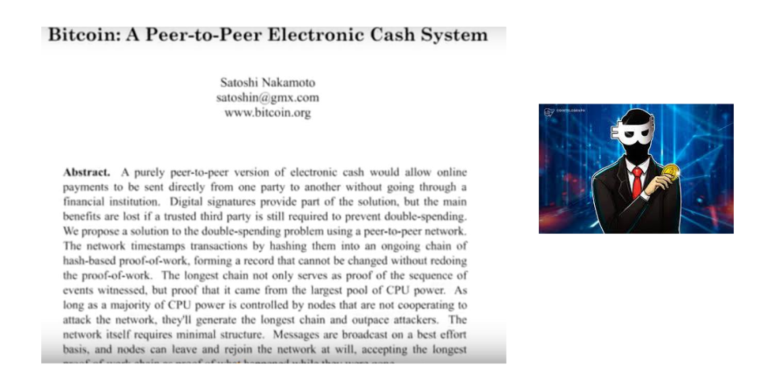

Slide 18
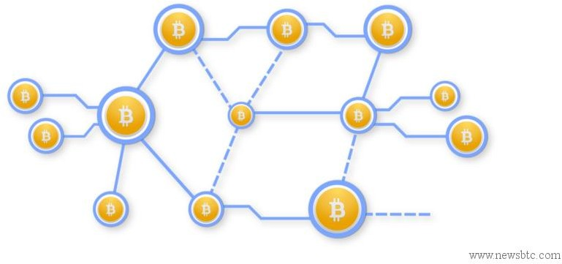
Bitcoin network is public
Source code is open source
Owner uses private key to spend bitcoins
Public ledger: All bitcoin exchanges are visible to everyone on the network
Transfer/Spending of coins require very little fee
Transactions are validated by miners who get rewarded

Slide 19
How exactly blockchain is implemented?

Slide 20



Blockchain?
Decentralized system for exchange of value
Uses a shared distributed ledger
Transaction immutability achieved by way of blocks & chaining
Leverages consensus mechanism for validating the transactions
Uses cryptography for trust, accountability, security

Slide 21
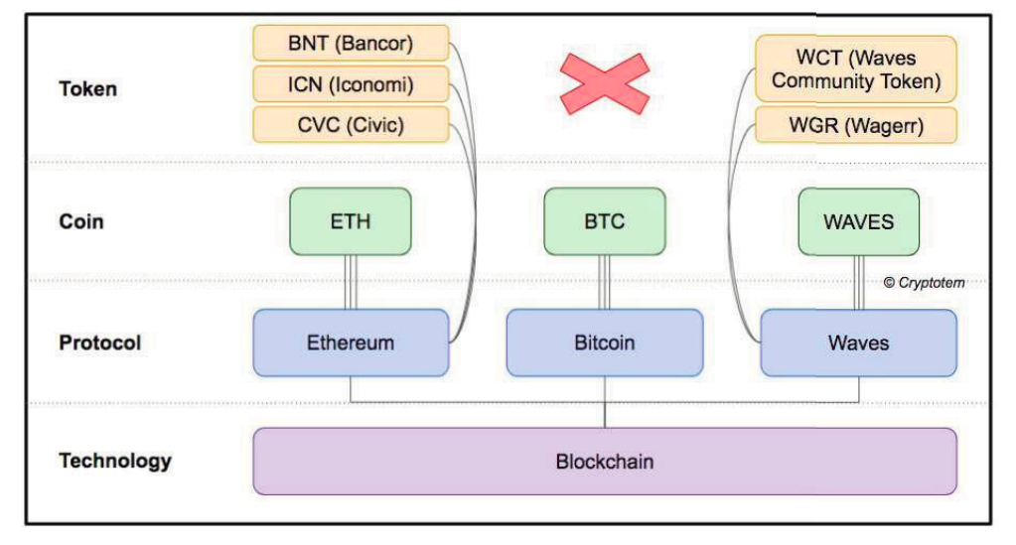
What is Bitcoin

Slide 22
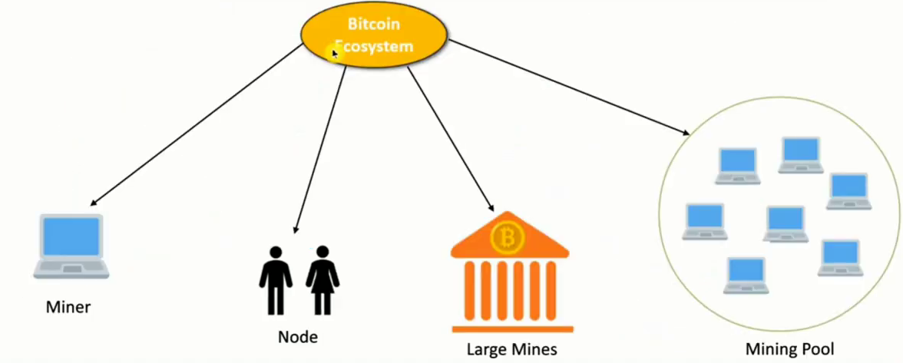
Bitcoin Ecosystem

Slide 23
Bitcoin—A user's perspective
Elements of Bitcoin
• Digital keys
• Addresses
• Transactions
• Blockchain
• Miners
• The Bitcoin network
• Wallets (client software)

Slide 24
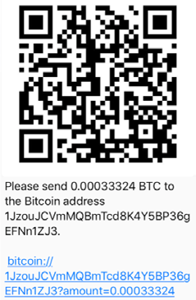
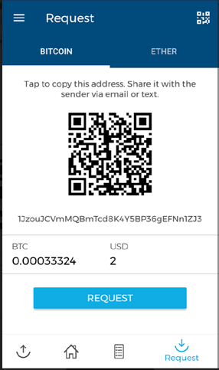
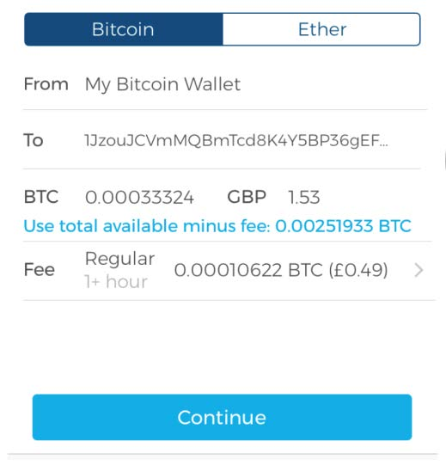
Bitcoin- User’s Perspective (2)

Slide 25
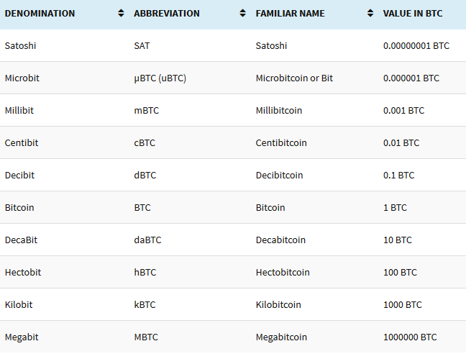
Bitcoin denominations

Slide 26
Bitcoin’s Monetary Policy
Digital Currency Regulation
Demand-supply
-The Halving every 4-year or after 2,10,000 blocks.
-The Block Frequency

Slide 27
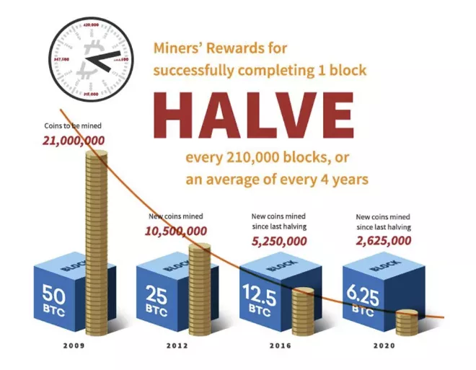
The Halving

Slide 28
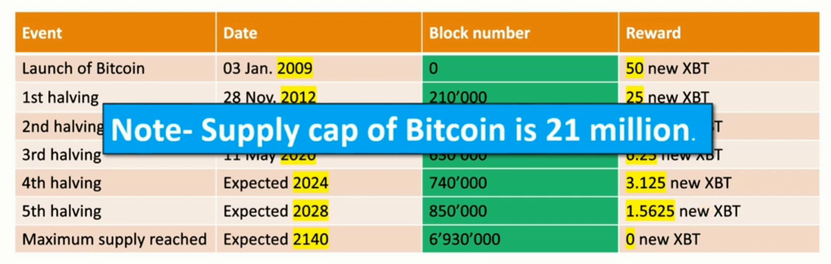
Bitcoin Supply

Slide 29

Block Frequency

Slide 30
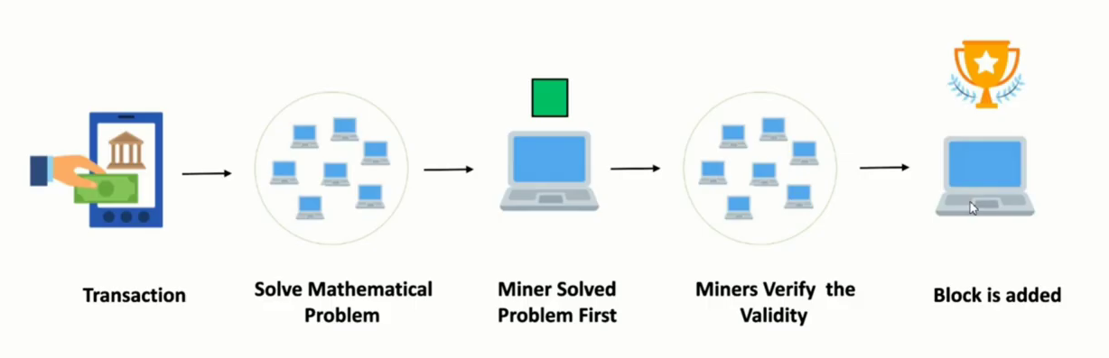
Bitcoin Mining

Slide 31
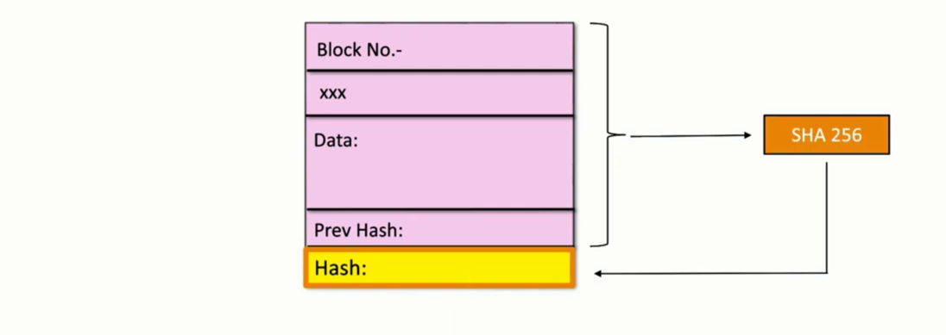
The Nonce

Slide 32
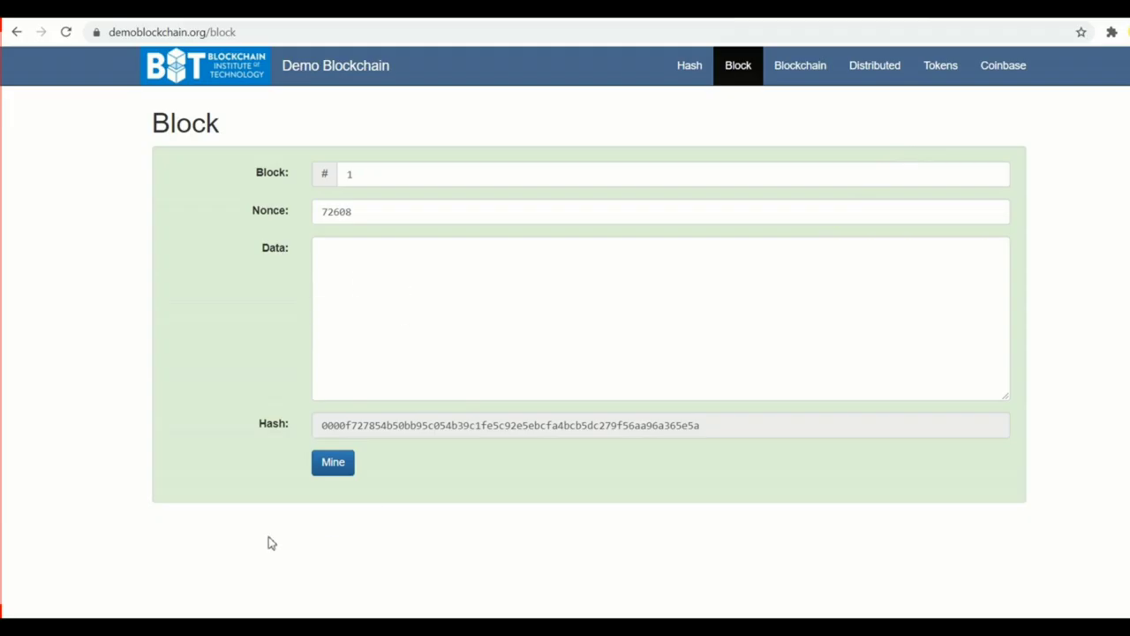
Blockchain Demo

Slide 33
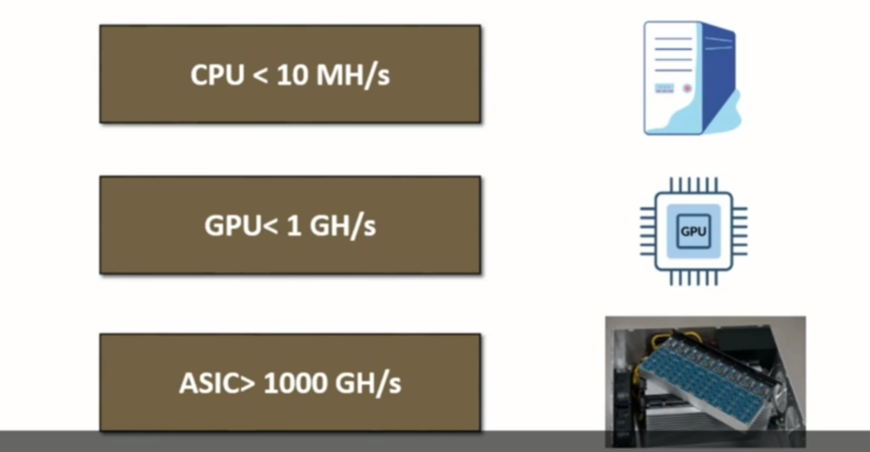
CPUvsGPUvs ASIC

Slide 34
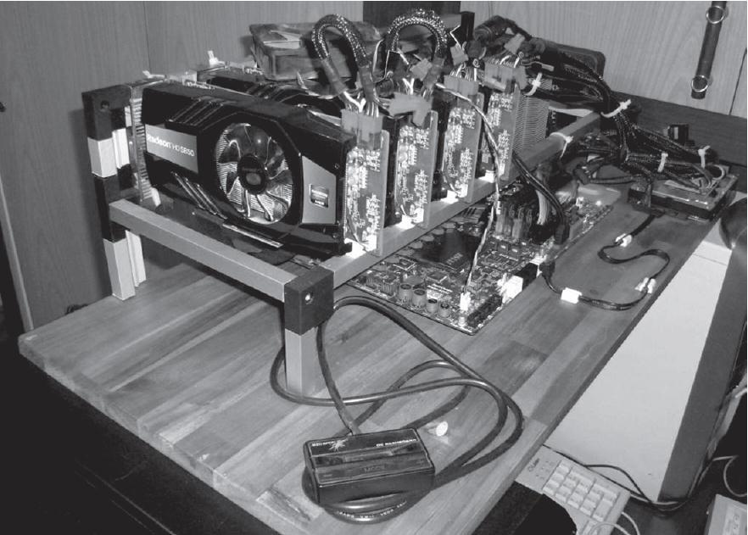
Mining Systems-GPU

Slide 35
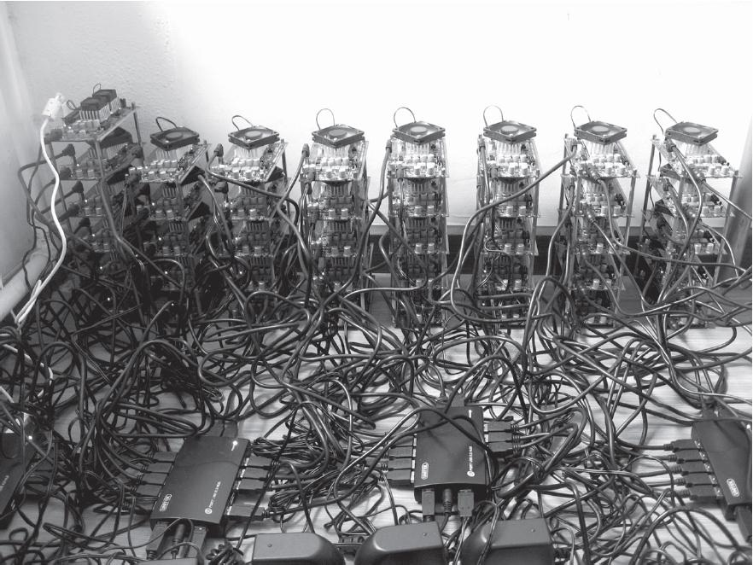
Mining System- FPGA

Slide 36
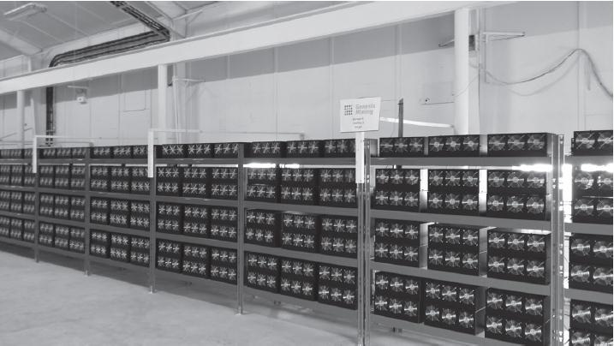
Mining System- ASIC

Slide 37
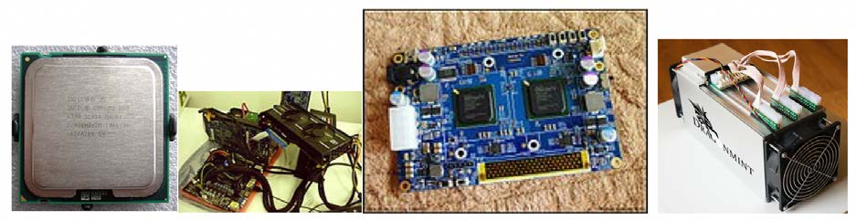
Mining Systems

Slide 38
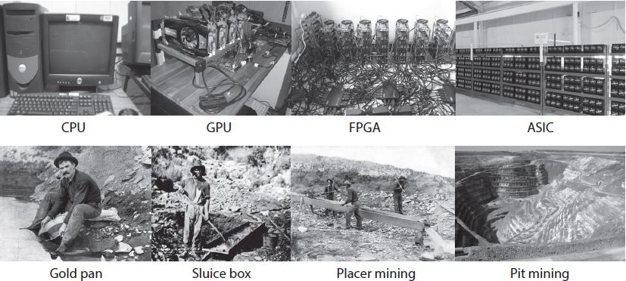
Mining Systems-CPU,GPU,FPGA and ASIC

Slide 39
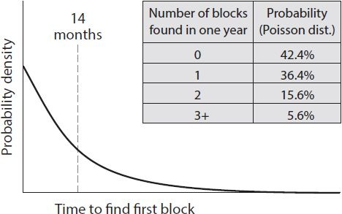

Slide 40
Network difficulty
Network difficulty refers to a measure of how difficult it is to find a new block, or in other words, how difficult it is to find a hash below the given target.
New blocks are added to the blockchain approximately every 10 minutes, and the network difficulty is adjusted dynamically every 2,016 blocks in order to maintain a steady addition of new blocks to the network.
Network difficulty is calculated using the following equation:
Target = Previous target * Time/2016 * 10 minutes

Slide 41
Nonce Range
32 bit
2^32 ~ 4 billion
0-2^32-1 Nonce Range

Slide 42
How Mining Works: Timestamp
All possible hashes
Largest
Block ID:
Nonce:
Previous Hash
DATA:
Tx data
Target (‘00000’)
-----------------------------
Hash: 00000DA
Smallest

Slide 43
How Mining Works: Timestamp
All possible hashes
Largest
Block ID:
Nonce:
Previous Hash
Timestamp
DATA:
Tx data
Target (‘00000’)
-----------------------------
Smallest

Slide 44
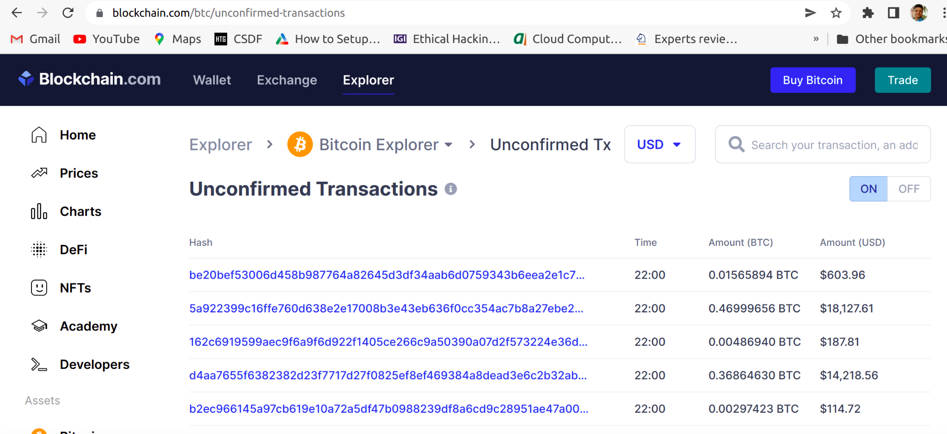
Mempool:

Slide 45
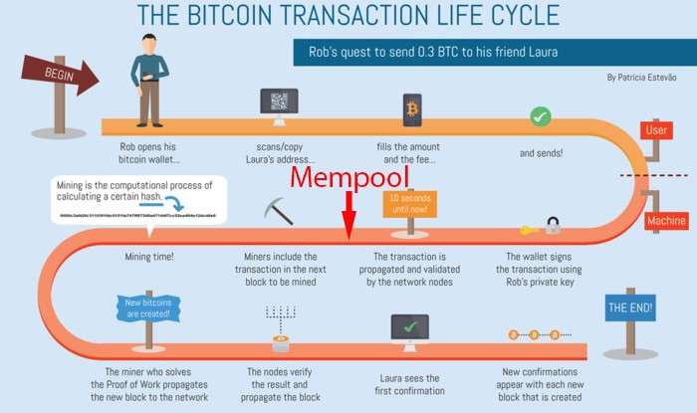
Mempool:
Bitcoin transaction life-cycle with Mempool. Image Source

Slide 46
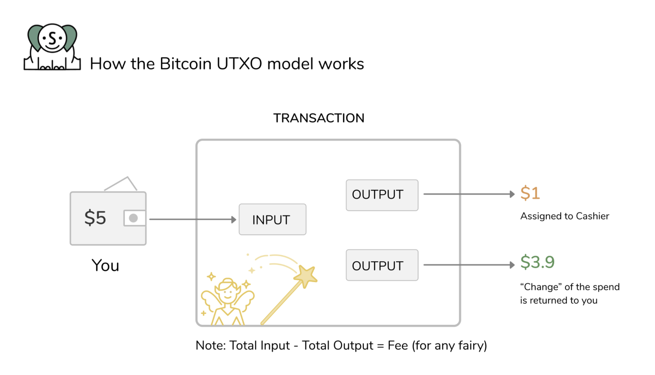
UTXO

Slide 47
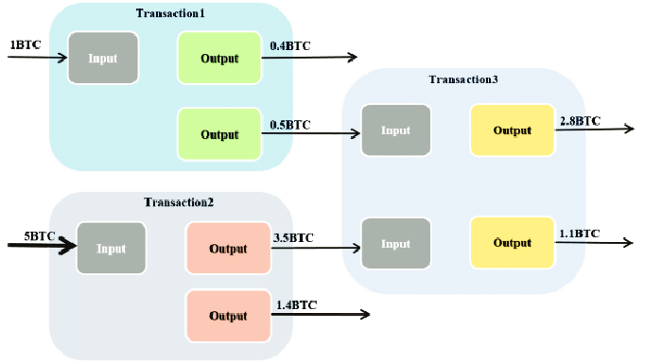
UTXO(2)

Slide 48
Wallets
The wallet software is used to generate and store cryptographic keys. It performs various useful functions, such as receiving and sending Bitcoin, backing up keys, and keeping track of the balance available.
Bitcoin client software usually offers both functionalities: Bitcoin client and wallet.
On disk, the Bitcoin Core client wallets are stored as a Berkeley DB file:
$ file wallet.dat
wallet.dat: Berkeley DB (Btree, version 9, native byte-order

Slide 49
Bitcoin Improvement Proposals (BIP)
These documents, also referred to as BIPs, are used to propose improvements or inform the Bitcoin community about the improvements suggested, the design issues, or some aspects of the Bitcoin ecosystem. There are three types of BIPs:
• Standard BIP: Used to describe the major changes that have a major impact on the Bitcoin system; for example, block size changes, network protocol changes, or transaction verification changes.
• Process BIP: A major difference between standard and process BIPs is that standard BIPs cover protocol changes, whereas process BIPs usually deal with proposing a change in a process that is outside the core Bitcoin protocol. These are implemented only after a consensus among Bitcoin users.
• Informational BIP: These are usually used to just advise or record some information about the Bitcoin ecosystem, such as design issues.

Slide 50
Segregated Witness
The SegWit or Segregated Witness is a soft fork-based upgrade of the Bitcoin protocol that addresses weaknesses such as throughput and security in the Bitcoin protocol.

Slide 51
References:
[1] Mastering Blockchain 3/e by Imran Bashir, Packt Publications
[2] https://learnmeabitcoin.com/
[3] Everything You Need To Know About Bitcoin
https://101blockchains.com/bitcoin-guide/
[4] Investopedia
https://www.investopedia.com/terms/b/bitcoin.asp#toc-what-is-bitcoin

Slide 52
Introduction to Blockchain Technology:
Definition of Blockchain,Elements of Blockchain Technology,The architecture of Blockchain Technology
[1] What is Blockchain? Simple Explanation
https://youtu.be/SSo_EIwHSd4?list=RDLVSSo_EIwHSd4
[2] What is BLOCKCHAIN? The best explanation of blockchain technology
https://youtu.be/3xGLc-zz9cA?list=RDLVSSo_EIwHSd4
[3] Blockchain 101- A Visual Demo by Anders Brownworth
https://youtu.be/SSo_EIwHSd4?list=RDLVSSo_EIwHSd4
[4] Blockchain 101 - Part 2 - Public / Private Keys and Signing
https://youtu.be/xIDL_akeras?list=RDCMUCx7YSpyYtgaYik1Wen9jYSA
[5] Bitcoin mining with 15 lines of python code | Python Bitcoin Tutorial
https://youtu.be/ZhnJ1bkIWWk

Slide 53
References
[1] The Bitcoin whitepaper was published in 2008 under the pseudonym Satoshi Nakamoto.
https://bitcoin.org/bitcoin.pdf
[2] Know About The Best Blockchain Open Source Projects
https://101blockchains.com/blockchain-open-source/
[3] Understand the Blockchain in Two Minutes
https://youtu.be/r43LhSUUGTQ
[4] But how does bitcoin actually work?
https://youtu.be/bBC-nXj3Ng4
[5] The Blockchain-Enabled Future of Telecommunications by Dennis Carroll
https://slideplayer.com/slide/17245257/

